Slide 1

Year 9 Linear Relationships Investigation
Name
Class
Teacher
Semester 2
Term 4
1

Slide 2

24
7
30
Tasks
24
7
30
Essential Question
Complete the tasks on this side (left) of your page
You should be ticking these off!
Questions
Notes
Write your notes on this side (right) of your page
Summary
Have YOU been doing your summaries?
Your book, your responsibility!

Slide 3
24
7
30
Date
Linear Relationships Investigation
EQ – What is a line of best fit and how do we find it using scatter plots?
Summary:

Slide 4
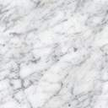

Scatter Graphs
Scatter graphs are used to show whether there is a relationship between two sets of data. The relationship between the data can be described as either:
1. A positive correlation. As one quantity increases so does the other.
2. A negative correlation. As one quantity increases the other decreases.
3. No correlation. Both quantities vary with no clear relationship.
Height
Soup Sales
Shoe Size
Shoe Size
Temperature
Annual Income
Positive Correlation
Negative correlation
No correlation

Slide 5
Scatter Graphs
Scatter graphs are used to show whether there is a relationship between two sets of data. The relationship between the data can be described as either:
1. A positive correlation. As one quantity increases so does the other.
2. A negative correlation. As one quantity increases the other decreases.
3. No correlation. Both quantities vary with no clear relationship.
A negative correlation is characterised by a straight line with a negative gradient.
A positive correlation is characterised by a straight line with a positive gradient.
Height
Soup Sales
Shoe Size
Shoe Size
Temperature
Annual Income

Slide 6
State the type of correlation for the scatter graphs below and write a sentence describing the relationship in each case.
1
Positive
2
Negative
3
None
Physics test scores
Petrol consumption (mpg)
Height
Maths test scores
Car engine size (cc)
Maths 9 Results
There is no relationship between Maths 9 results and the height of students.
As the engine size of cars increase, they use more petrol. (Less mpg)
People with higher maths scores tend to get higher physics scores.

Slide 7
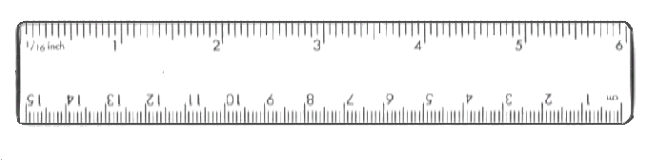
Drawing a Line of Best Fit
A line of best fit is a straight line that best represents the data on a scatter plot. It allows us to:
Understand the type and strength of the relationship between two sets of data
Predict missing Y values for given X values, or missing X values for given Y values
The sum of the vertical distances above the line should be roughly the same as those below.

Slide 8
Question 1
(1). The table below shows the shoe size and mass of 10 men.
(a) Plot a scatter graph for this data and draw a line of best fit.
Plotting the data points/Drawing a line of best fit/Answering questions.
Size
5
12
7
10
10
9
8
11
6
8
Mass
65
97
68
92
78
78
76
88
74
80
100
95
90
85
80
Mass (kg)
75
70
65
60
4
5
6
7
8
9
10
11
12
13
Shoe Size

Slide 9
(1). The table below shows the shoe size and mass of 10 men.
(a) Plot a scatter graph for this data and draw a line of best fit.
Size
5
12
7
10
10
9
8
11
6
8
Mass
65
97
68
92
78
78
76
88
74
80
100
95
90
85
80
Mass (kg)
75
70
65
60
4
5
6
7
8
9
10
11
12
13
Shoe Size

Slide 10
(1). The table below shows the shoe size and mass of 10 men.
(a) Plot a scatter graph for this data and draw a line of best fit.
Size
5
12
7
10
10
9
8
11
6
8
Mass
65
97
68
92
78
78
76
88
74
80
100
95
90
85
80
Mass (kg)
75
70
65
60
4
5
6
7
8
9
10
11
12
13
Shoe Size

Slide 11
(1). The table below shows the shoe size and mass of 10 men.
(a) Plot a scatter graph for this data and draw a line of best fit.
Size
5
12
7
10
10
9
8
11
6
8
Mass
65
97
68
92
78
78
76
88
74
80
100
95
90
85
80
Mass (kg)
75
70
65
60
4
5
6
7
8
9
10
11
12
13
Shoe Size

Slide 12
(1). The table below shows the shoe size and mass of 10 men.
(a) Plot a scatter graph for this data and draw a line of best fit.
Size
5
12
7
10
10
9
8
11
6
8
Mass
65
97
68
92
78
78
76
88
74
80
100
95
90
85
80
Mass (kg)
75
70
65
60
4
5
6
7
8
9
10
11
12
13
Shoe Size

Slide 13
(1). The table below shows the shoe size and mass of 10 men.
(a) Plot a scatter graph for this data and draw a line of best fit.
Size
5
12
7
10
10
9
8
11
6
8
Mass
65
97
68
92
78
78
76
88
74
80
100
95
90
85
80
Mass (kg)
75
70
65
60
4
5
6
7
8
9
10
11
12
13
Shoe Size

Slide 14
(1). The table below shows the shoe size and mass of 10 men.
(a) Plot a scatter graph for this data and draw a line of best fit.
Size
5
12
7
10
10
9
8
11
6
8
Mass
65
97
68
92
78
78
76
88
74
80
100
95
(b) Draw a line of best fit and comment on the correlation.
90
87 kg
Positive
85
80
(c) Use your line of best fit to estimate:
The mass of a man with shoe size 10½.
(ii) The shoe size of a man with a mass of 69 kg.
Mass (kg)
75
70
65
Size 6
60
4
5
6
7
8
9
10
11
12
13
Shoe Size

Slide 15
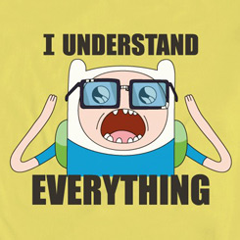
Do you understand?
Then it’s time to throw Barbie off a railing
Notes:
Check for Understanding

